Slide 1
Automating homepage recipe selection
A solution for Tasty Bytes

Slide 2
BUSINESS Goals
support
A solution that supports the Product Manager in selecting popular recipes for the homepage
automation
A solution that automates the process selecting popular recipes for the homepage
precision
A solution that will accurately select popular recipes 80% of the time

Slide 3
Data
Selection of Recipe Information
 | Recipe | Calories | Carbohydrate | Sugar | Protein | Category | Servings | High_traffic
0 | 1 | NaN | NaN | NaN | NaN | Pork | 6 | High
1 | 2 | 35.48 | 38.56 | 0.66 | 0.92 | Potato | 4 | High
2 | 3 | 914.28 | 42.68 | 3.09 | 2.88 | Breakfast | 1 | NaN
3 | 4 | 97.03 | 30.56 | 38.63 | 0.02 | Beverages | 4 | High
4 | 5 | 27.05 | 1.85 | 0.80 | 0.53 | Beverages | 4 | NaN

Slide 4
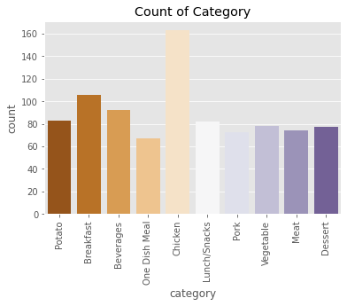
Key findings
Category variable
In the data provided there are 10 different food types present as categories.
Chicken
Breaskfast
Beverage

Slide 5
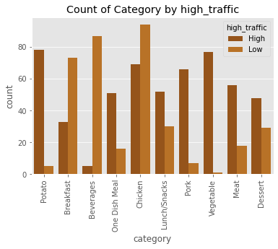
Key findings
Category variable
On a deep dive into the category, certain food category tend to result in a higher traffic with others having inverse effect.
Vegetable
Potato
Beverage

Slide 6
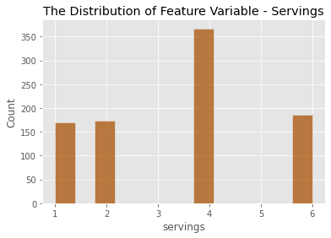
Key findings
Servings variable
In the data provided there four main different serving with significant bais in the distribution.

Slide 7
Outcomes
Two Models – Logistic Regression and Random Forest Classifier Model
Calories
Carbohydrate
Logistic Regression Model
High Traffic Recipe
Sugar
Protein
Random Forest Classifier Model
High Traffic Recipe
Category
Servings

Slide 8
Outcomes
Two Metrics – Precision Score and F1 Score
Model | Precision score | F1 Score
Purpose | Accuracy of the positive prediction | Combination of Precision and Recall
Range of Values | 0 - 1 | 0 - 1

Slide 9
Outcomes
The Logistics Regression Model is better at making correct high traffic prediction
Model | Precision score | F1 Score
Logistic Regression Model | 0.85 | 0.77
Random Forest Classifier Model | 0.80 | 0.78

Slide 10
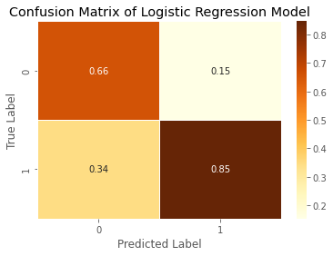
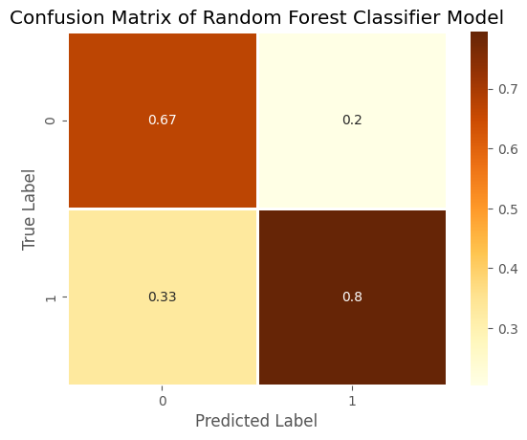
Outcomes
Our KPI – Accuracy of High Traffic Recipe Prediction

Slide 11
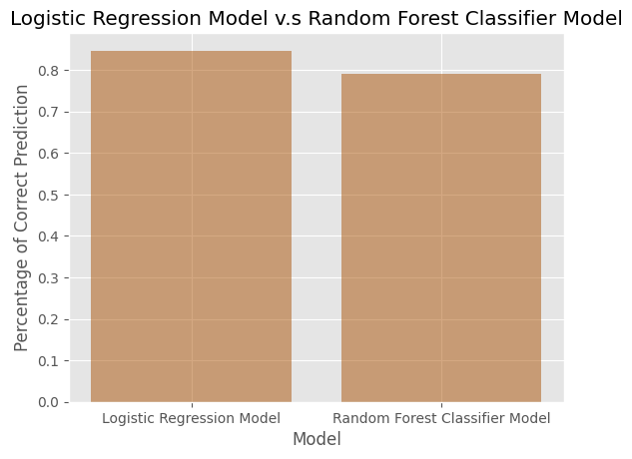
Outcomes
Our KPI – Accuracy of High Traffic Recipe Prediction
Logistic Regression Model is performing better
85% of the prediction made by the logistic regression are correct classification of the traffic performance of the models

Slide 12
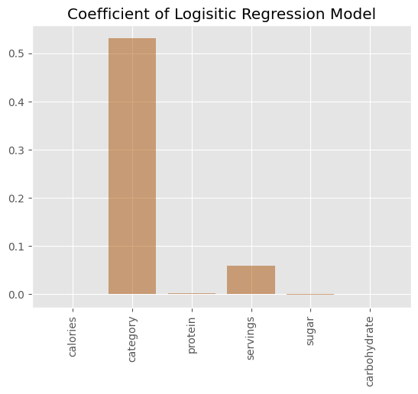
Outcomes
Feature Importance of the Models
Logistic Regression Model
Features
Category
Servings
Carbohydrate
Protein
Calories
Sugar

Slide 13
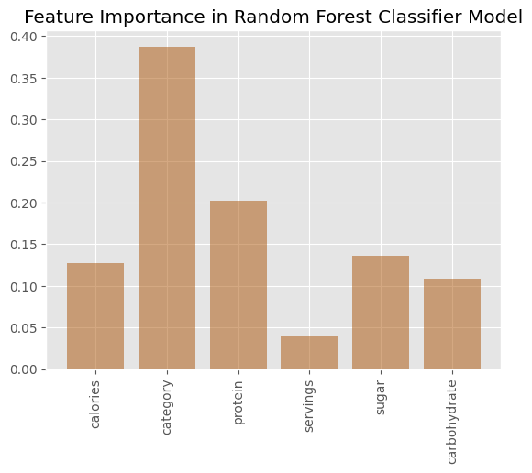
Outcomes
Feature Importance of the Models
Random Forest Classifier Model
Features
Category
Protein
Calories
Carbohydrate
Sugar
Servings

Slide 14
Recommendation
Test the model in the recent month using an A/B Test to compare the site traffic generated by the predicted recipe to those generated by the selection of the product manager.
Identify and fix errors to improve accuracy after testing.
Fully deploy the model using efficient deployment strategy, such as a plugin API for the website.
The model can be continuously improved by collecting more data, feature engineer and fine tuning parameter. This is important due to the limited number of categories in the category variable and the limited serving distribution.

Slide 15
Thank you
Musa Badaru

